Slide 1
Photomicrographs of Plant foods
Kale
Permission to reproduce original photomicrographs used to make this collection may be obtained from
Dr. David O. Norris at
david.norris@colorado.edu

Slide 2
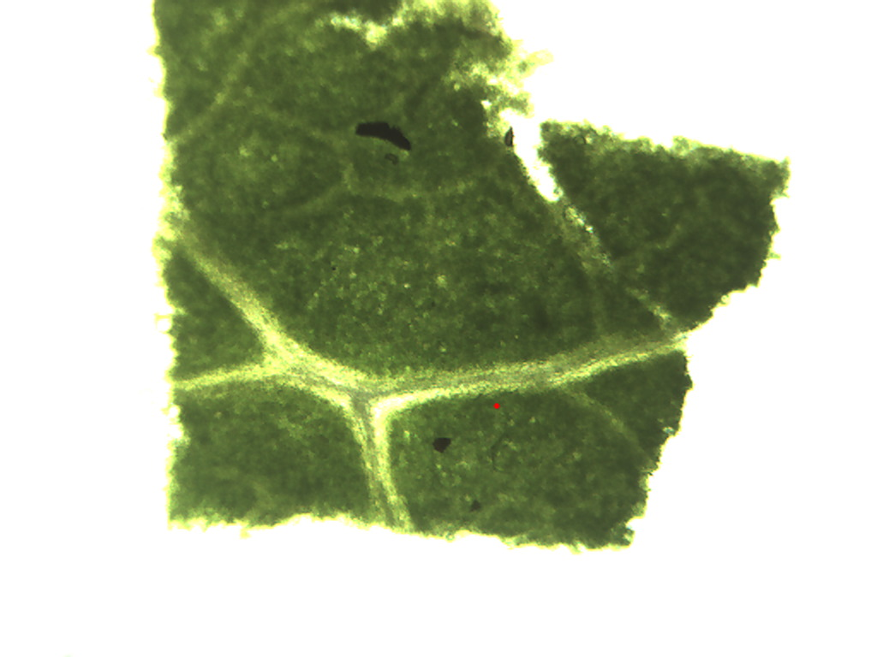
Notes:
242. Brassica oleacea L., var. acephala Kale. Leaf surface, 4X. Note prominent veins.

Slide 3
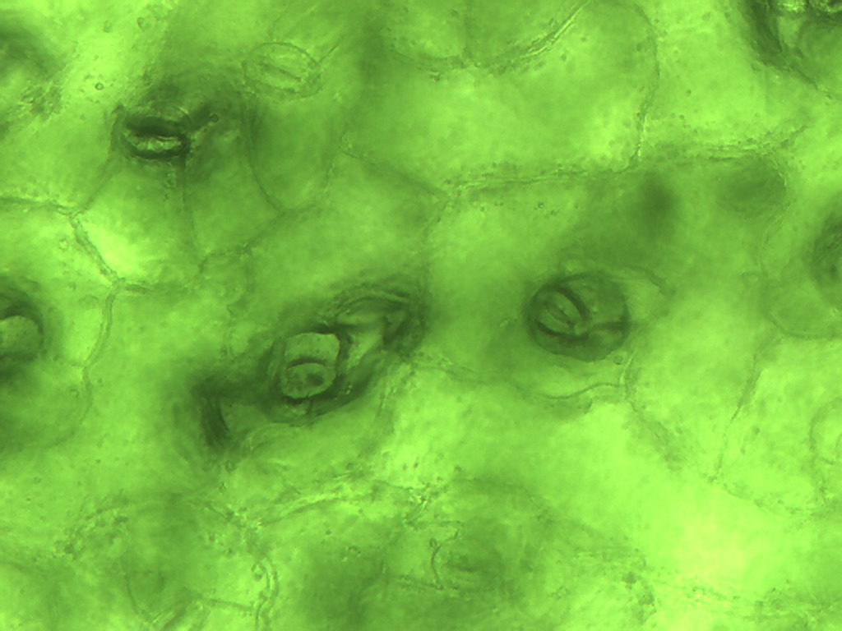
Notes:
243. Kale. Leaf epidermis with stomates (arrows), 25X. Compare epidermal cells with those of lettuce.

Slide 4
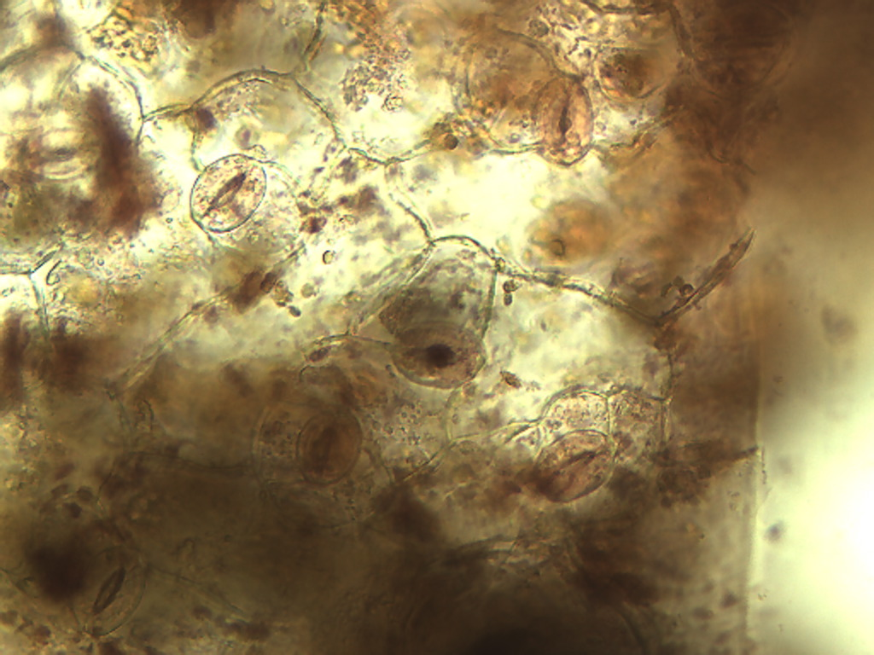
Notes:
244. Kale. Leaf epidermis with stomates (arrows), stained with safranin, 25X.

Slide 5
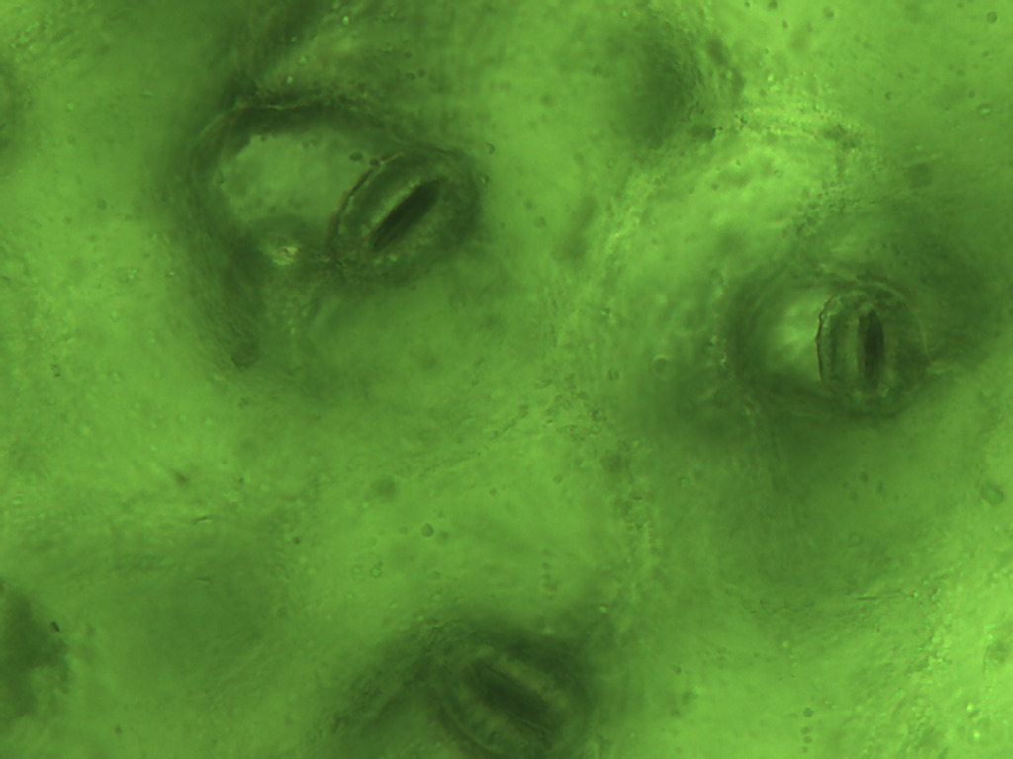
Notes:
245. Kale. Leaf epidermis with stomates (arrows), 40X.

Slide 6
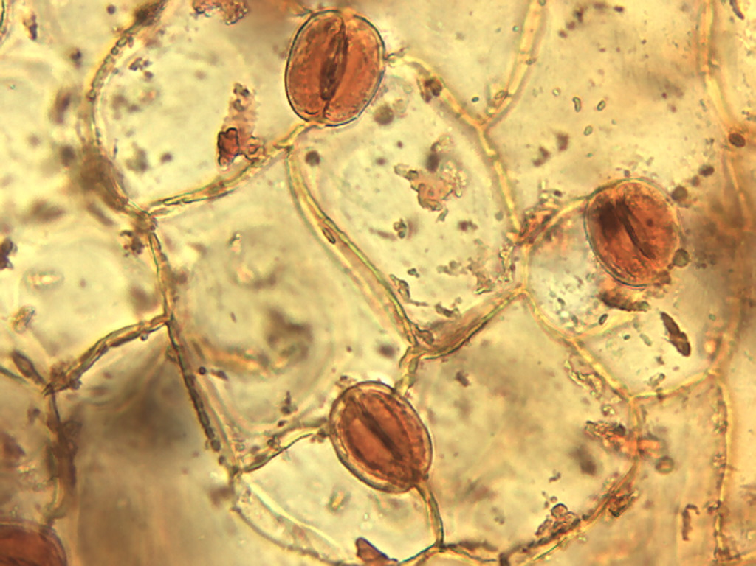
Notes:
246. Kale. Leaf epidermis with stomates (arrows), stained with safranin, 40X.

Slide 7
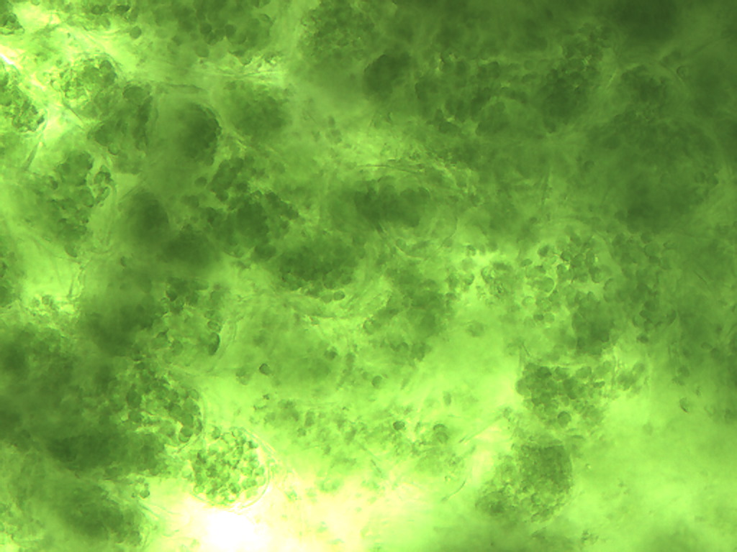
Notes:
247. Kale. Leaf photosynthetic parenchymal cells, 25X.

Slide 8
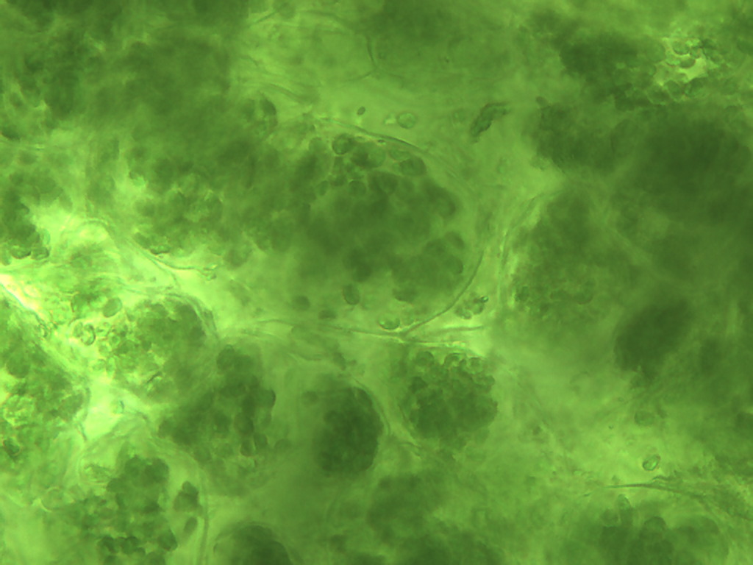
Notes:
248. Kale. Leaf photosynthetic parenchymal cells, 25X.

Slide 9
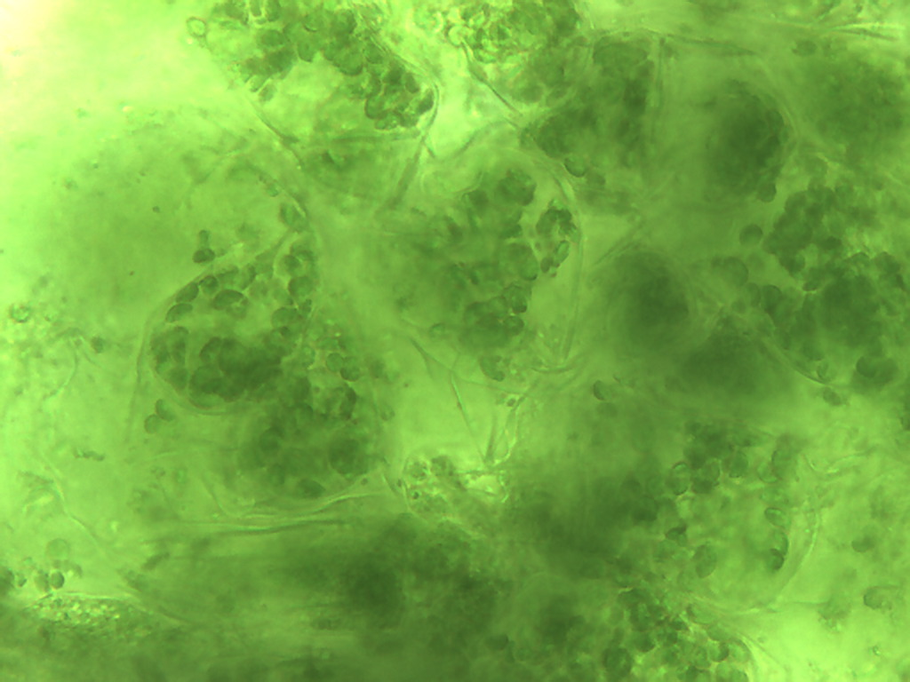
Notes:
249. Kale. Leaf photosynthetic parenchymal cells, 40X

Slide 10
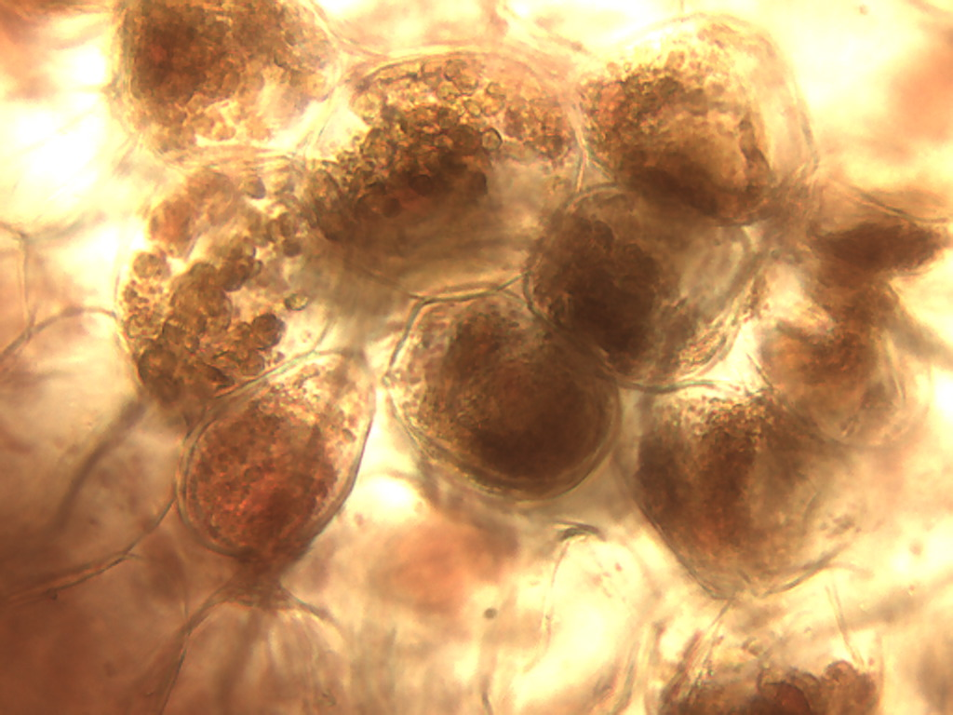
Notes:
250. Kale. Leaf photosynthetic parenchymal cells stained with safranin, 40X.

Slide 11
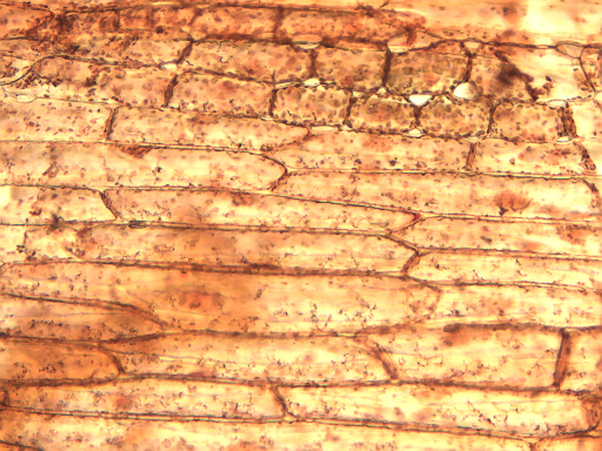
Notes:
251. Kale. Epidermis of petiole stained with safranin, 10X.

Slide 12
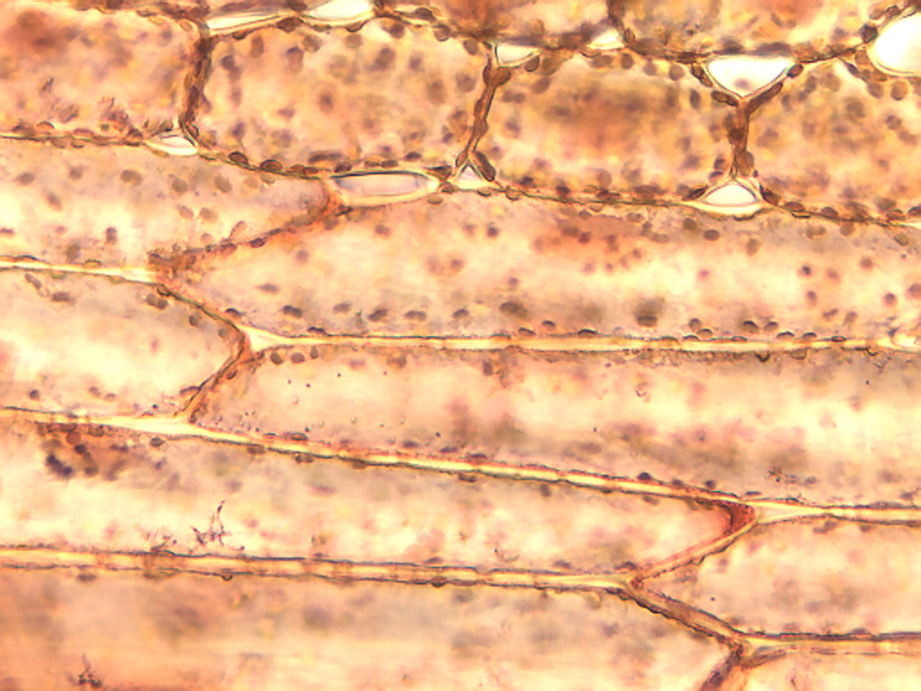
Notes:
252. Kale. Epidermal cells of petiole stained with safranin, 25X.

Slide 13
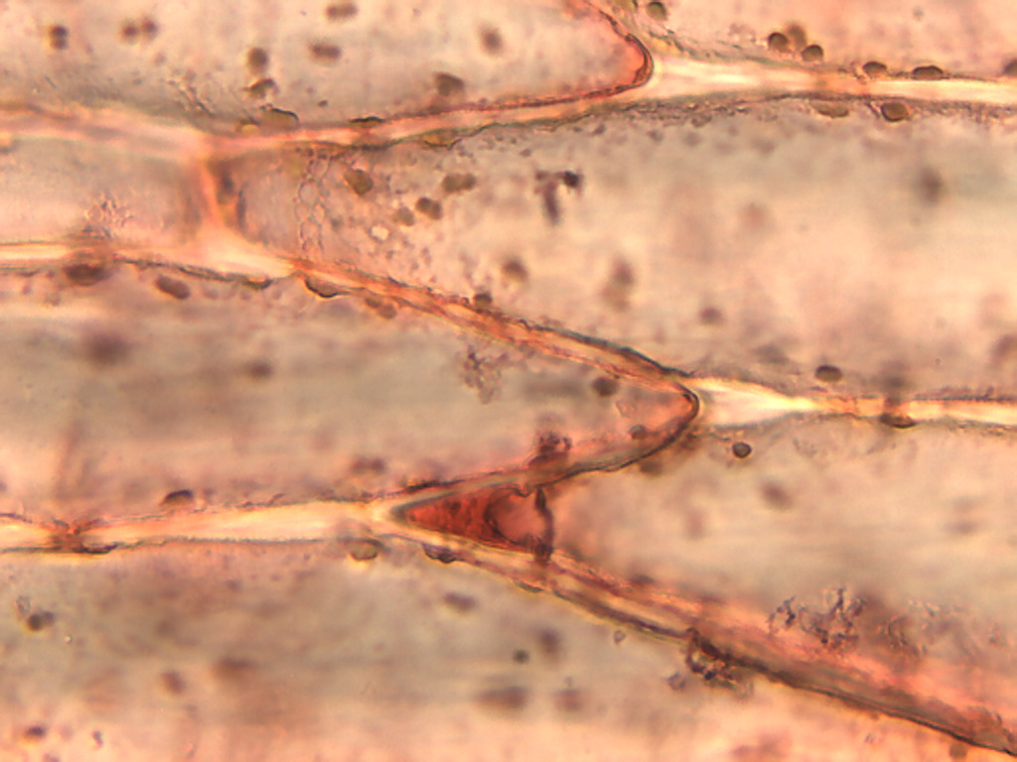
Notes:
253. Kale. Epidermis of petiole stained with safranin, 40X.

Slide 14
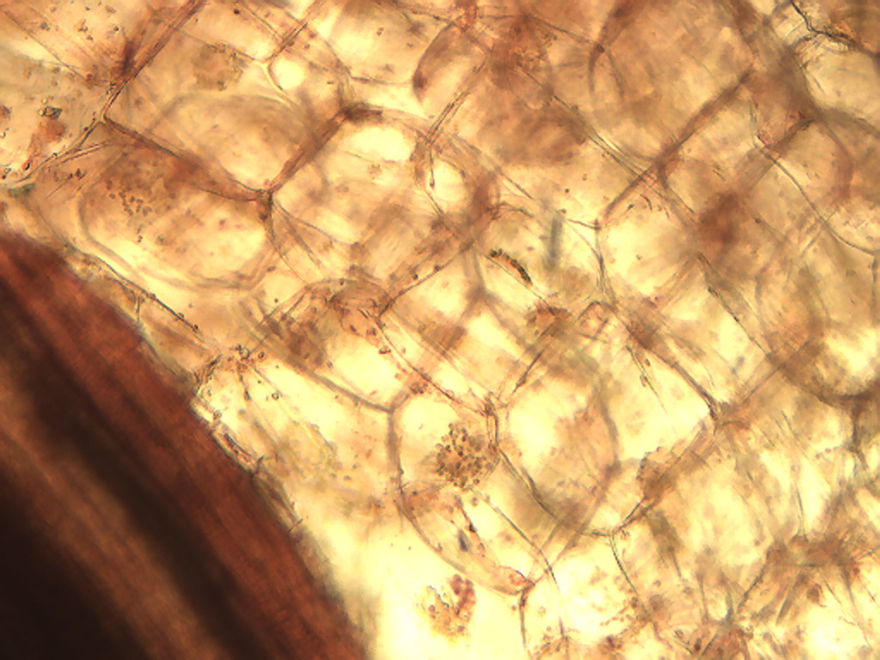
Notes:
254. Kale. Petriole parenchymal cells stained with safranin, 10X.

Slide 15
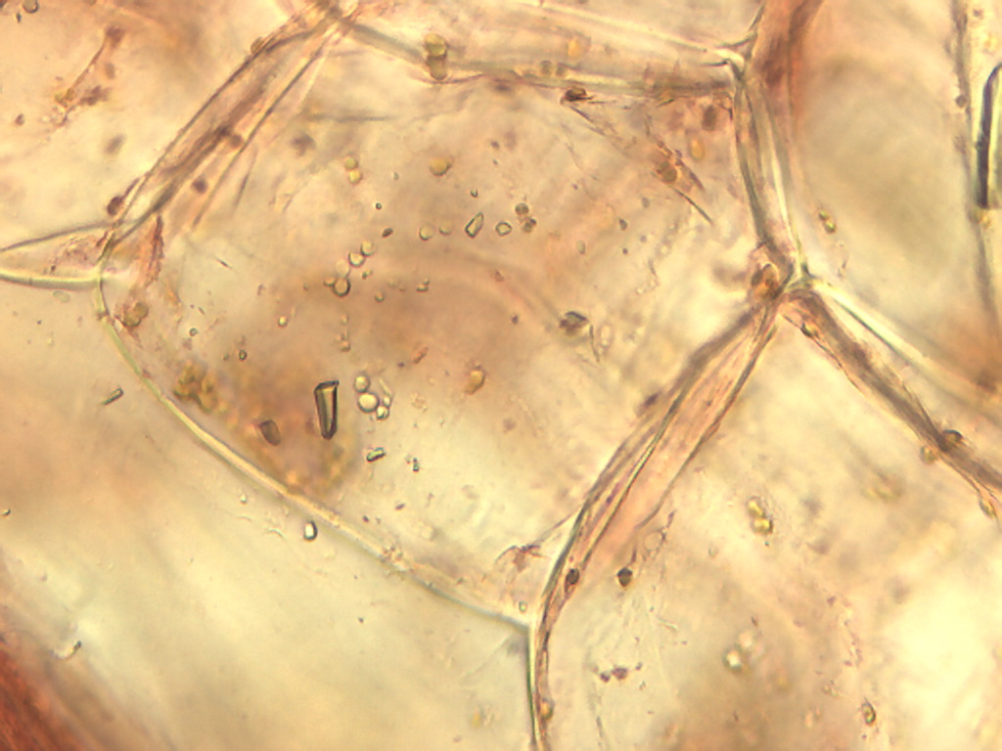
Notes:
255. Kale. Parenchymal cells of petiole, 25X.

Slide 16
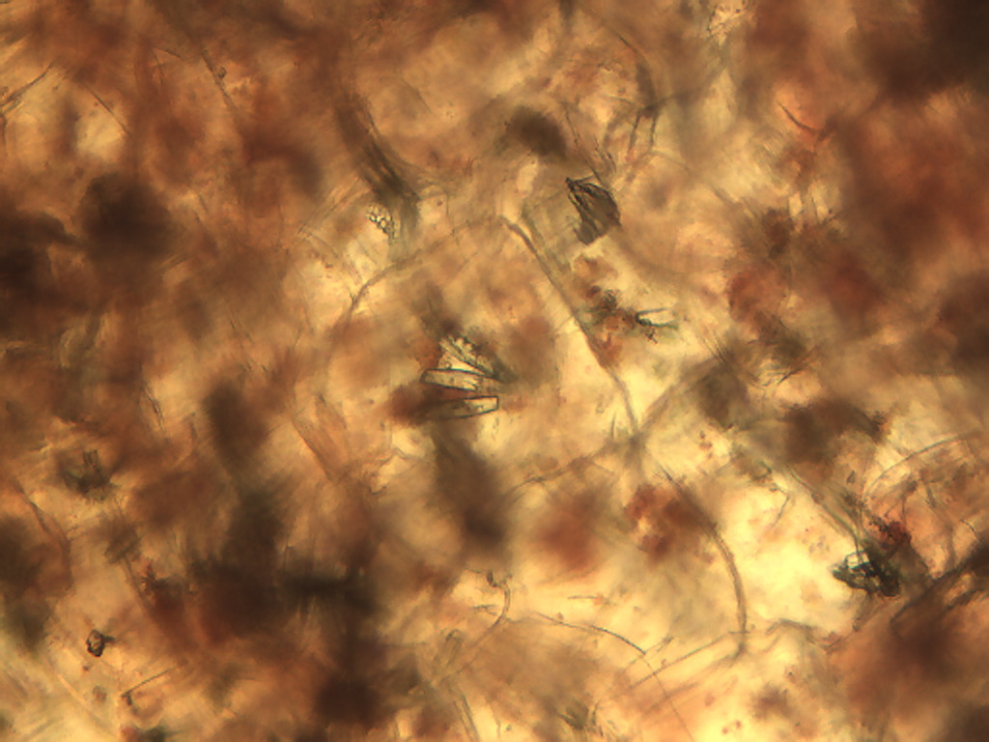
Notes:
256. Kale. Crystals in petiole, stained with safranin, 10X.

Slide 17
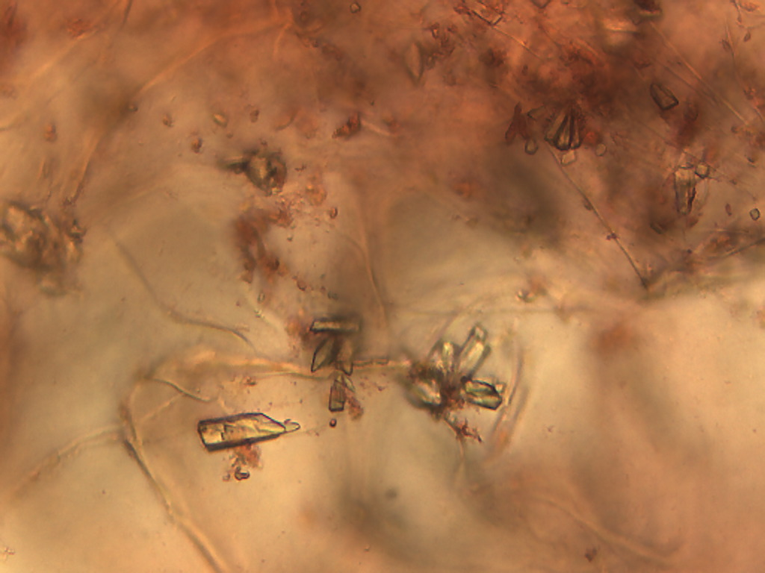
Notes:
257. Kale. Crystalline material in petiole stained with safranin, 25X.

Slide 18
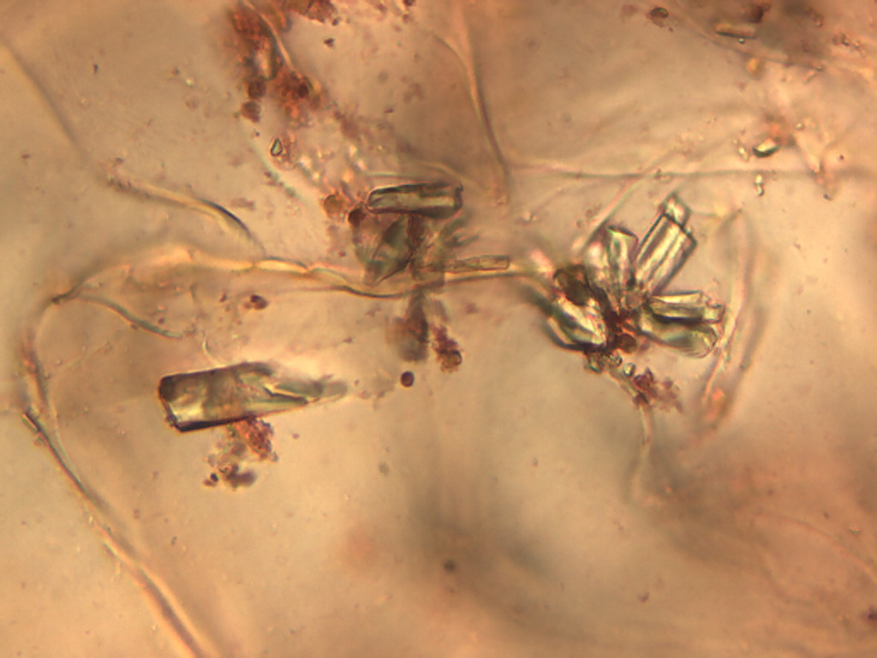
Notes:
258. Kale. Crystals in petiole stained with safranin, 40X.

